Slide 1
Genesis 31
Designed and Preached by Student Yap Mei Foong Uploaded by Dr. Rick Griffith • Singapore Bible College All files in many languages for free download at BibleStudyDownloads.org

Slide 2
Do you doubt?

Slide 3
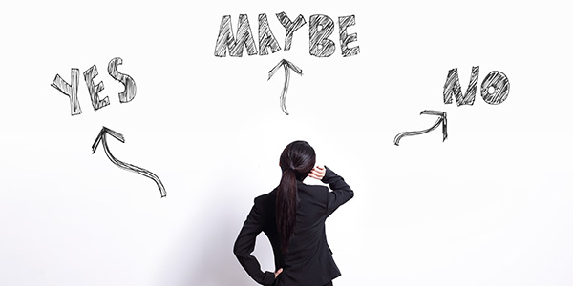
My voice? God’s will?

Slide 4
How to walk in faith with God when you face opposition.

Slide 5
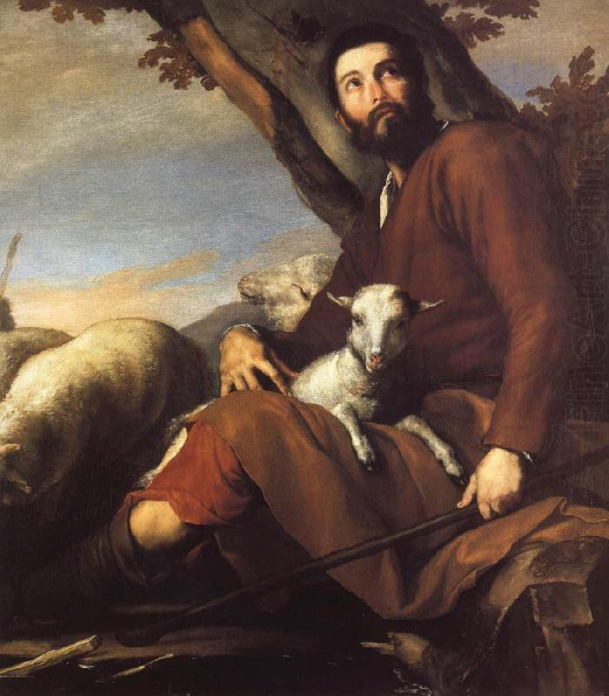
Jacob

Slide 6
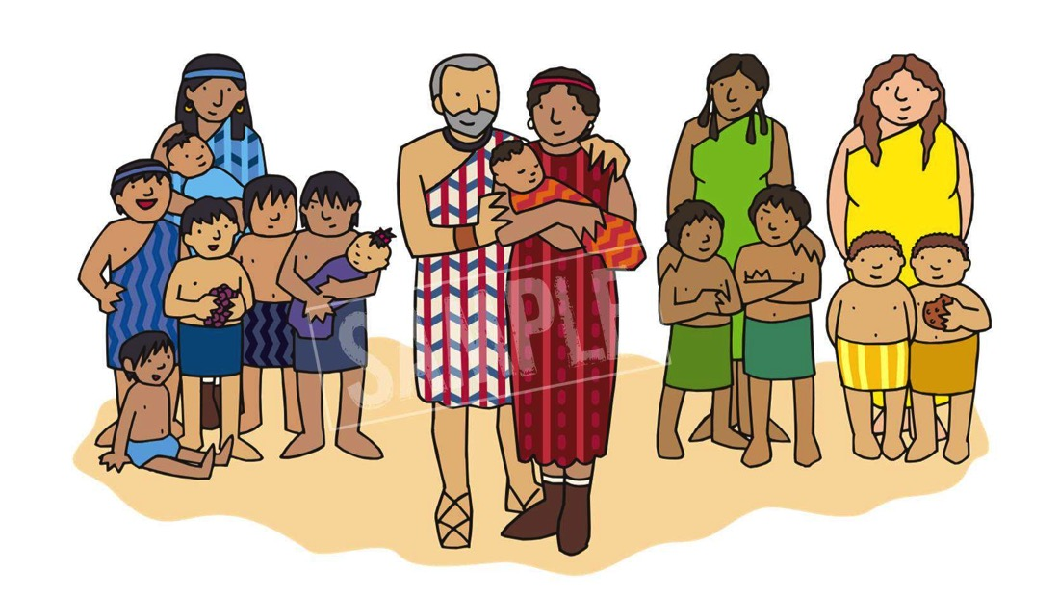
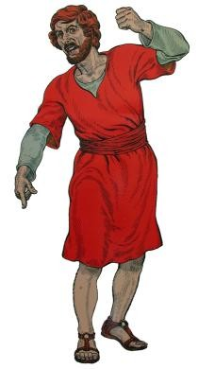

Slide 8
I. Obey & Go
A. God allows the hostile environment to force you to leave your comfort zone (vv.1-2).

Slide 9
I. Obey & Go
Jacob heard that Laban’s sons were saying, “Jacob has taken everything our father owned and has gained all this wealth from what belonged to our father.” ² And Jacob noticed that Laban’s attitude toward him was not what it had been.
Gen 31: 1-2

Slide 10
I. Obey & Go
A. God allows the hostile environment to force you to leave your comfort zone (vv.1-2).

Slide 11
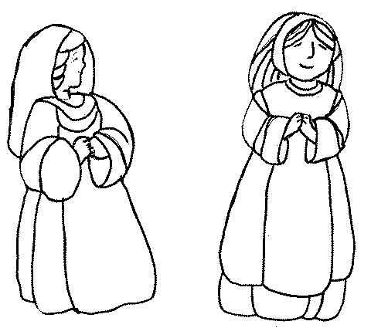
I. Obey & Go
B. God assures your calling in an unexpected way (vv.3-21).

Slide 12
I. Obey & Go
Then Rachel and Leah replied, “Do we still have any share in the inheritance of our father’s estate? Does he not regard us as foreigners? Not only has he sold us, but he has used up what was paid for us. Surely all the wealth that God took away from our father belongs to us and our children. So do whatever God has told you.”
Gen 31: 14-17

Slide 14
II. God is surely with you!
A. God protects you and brings you through all harm (vv.22-42).

Slide 15
II. God is surely with you!
1. God’s direct intervention (vv.22-25).
Then God came to Laban the Aramean in a dream at night and said to him, “Be careful not to say anything to Jacob, either good or bad.”
Gen 31: 24

Slide 16
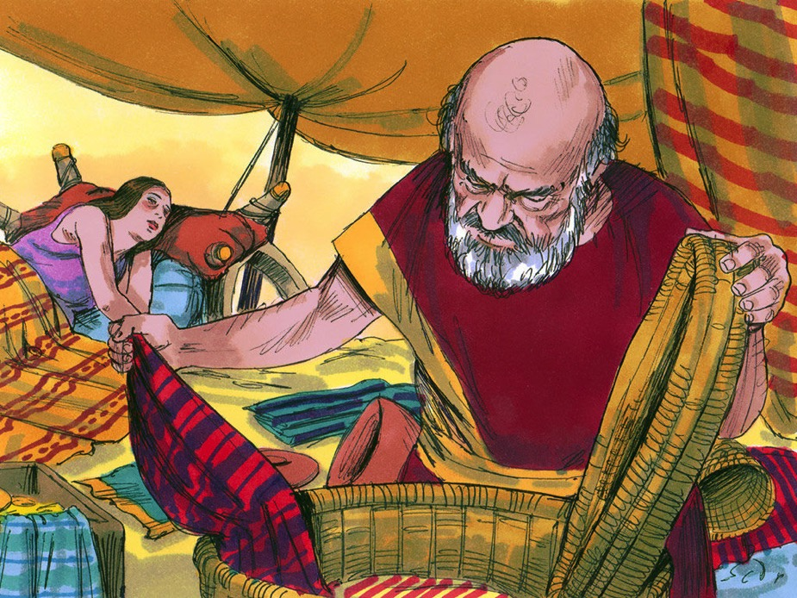
II. God is surely with you!
2. Rachel theft did not thwart God’s plan (vv.26-37).

Slide 17
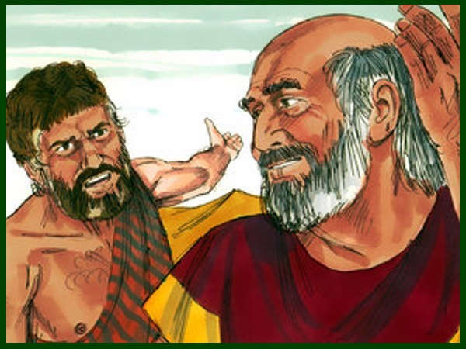
II. God is surely with you!
3. God enabled Jacob to defend himself from Laban’s wrong accusations (vv.38-42).

Slide 18
II. God is surely with you!
A. God protects you and brings you through all harm (vv.22-42).

Slide 19
II. God is surely with you!
B. God turns bad to good for his people in their obedience (vv.43-55).

Slide 20
II. God is surely with you!
We know that all things God works for the good of those who love Him,
who have been called according to His purpose.
Romans 8:28

Slide 21
II. God is surely with you!
God protects you and brings you through all harm (vv.22-42).
B. God turns bad to good for his people in their obedience (vv.43-55).

Slide 22
Obey & Go, for GOD is with you!

Slide 23
God is too wise to be mistaken God is too good to be unkind when you don’t understand when you don’t see His plan when you can’t trace His hand TRUST HIS HEART

Slide 24
Black

Slide 25
OT Preaching link at BibleStudyDownloads.org
Get this presentation and script for free!
Notes:
OT Preaching (op)

